Slide 1
MODULE CODE – MOD002726 MODULE NAME- Postgraduate Major Project SUPERVISOR- Dr.Janan, Faraz
Credit Card Fraud Detection Using Supervised and Deep Learning Models – A Comparative Study
STUID: 2028423 NAME: Anusha Mandalapu

Slide 2
Introduction:
Nowadays, everyone aspires to have a credit card and uses it to make purchases. This location has become a snare for hackers looking to steal money from consumers using credit cards.
The credit cards are stolen by some fraudsters and misuse them through money transactions or giving it to other criminals, is generally known as “Credit Card Fraud”
Predicting fraudulent transactions and preventing them is the point of interest for banks and credit card companies and various methods have been evolved which are using by many banks, companies.

Slide 3
Aim & Objectives :
The main aim of this paper is to assess the performance of the SMOTE family techniques across machine learning and deep learning models in identifying the credit card fraudulent transactions.
To generate synthetic data using Sampling techniques.
To train and test the models with balanced dataset.
To compare and analyse the performance of models and SMOTE family techniques.
To find out the best model with better accuracy and efficient performance.

Slide 4
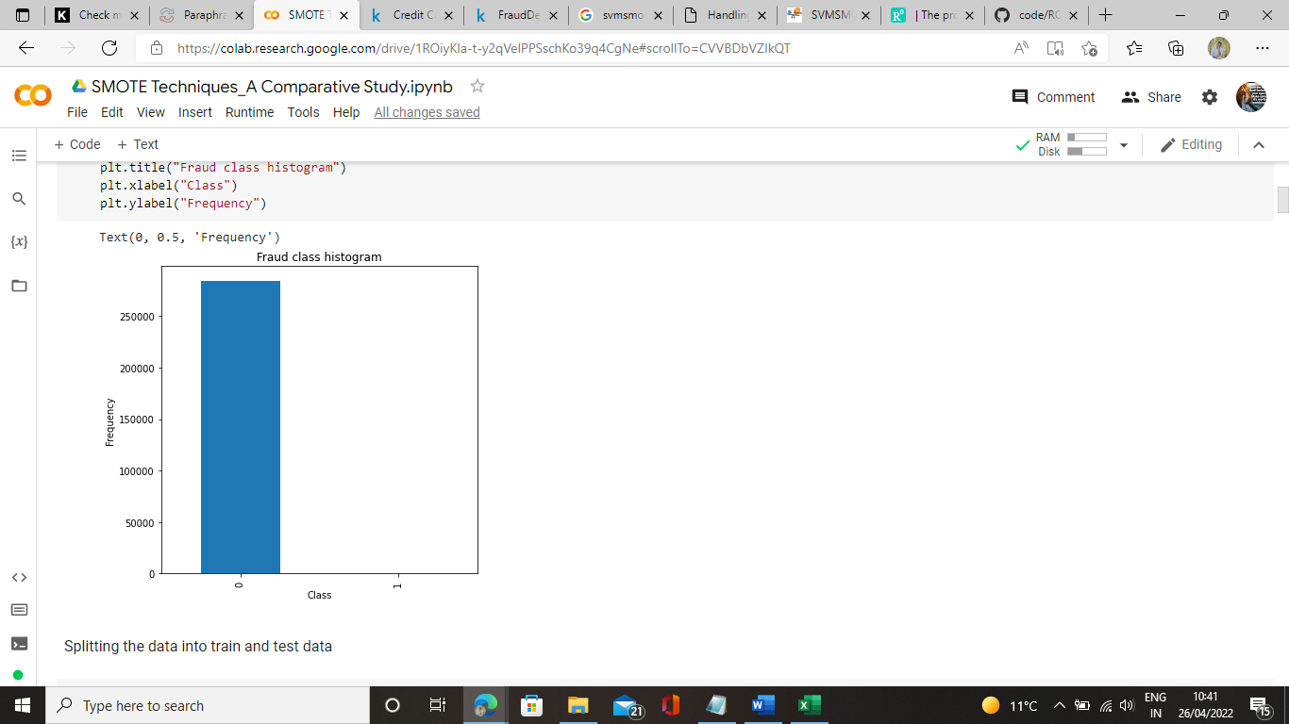
Data Collection:
The specific dataset that we utilize is additionally an imbalanced one. This specific dataset contains the record of exchanges made by European cardholders.
It has the records of 284,807 exchanges made over a span of two days, out of which 492 were found out to be extortion. The rate of false exchanges is found out to be extremely low. This dataset is profoundly unequal.
Fig 01: Fraud Class Histogram-Imbalanced Dataset

Slide 5
Data Collection :
Since giving exchange details of a client is considered to issue related to privacy, in this manner most of the highlights within the dataset are changed utilizing principal component analysis (PCA). V1, V2, V3,..., V28 are PCA connected features and rest i.e., ‘time’, ‘amount’ and ‘class’ are non-PCA connected highlights, as appeared in table.
SNO | Feature | Description
1. | Time | Time in seconds to specify the elapses between current transaction and first transaction.
2. | Amount | Transaction amount
3. | Class | 0-not fraud 1-fraud
Fig 02: Description of dataset features

Slide 6
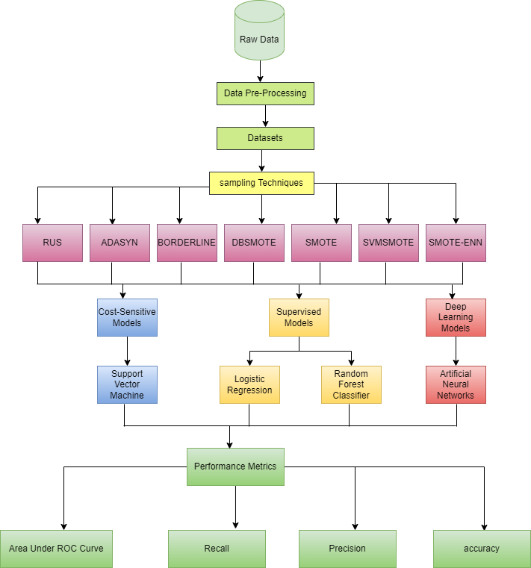
Methodologies:
Fig 03: Overview of the System

Slide 7
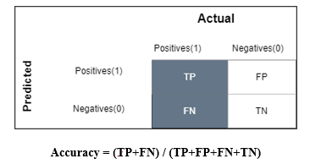
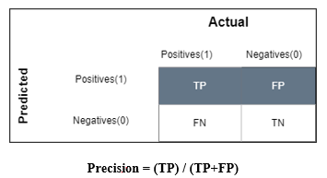
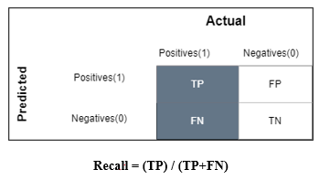
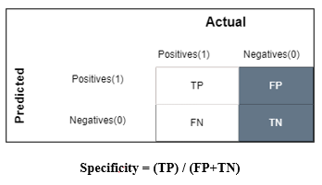
Metrics Evaluation:

Slide 8
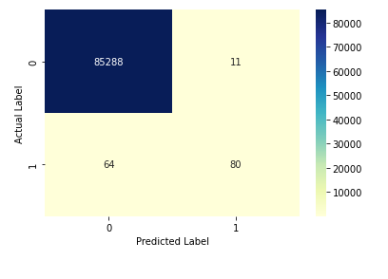
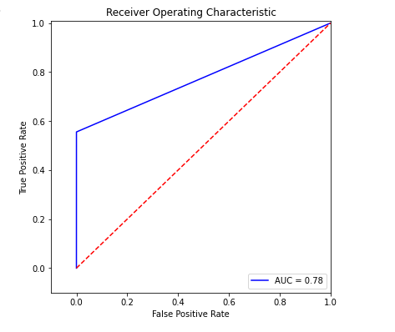
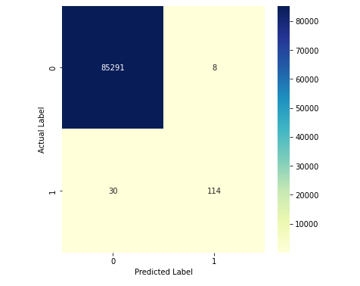
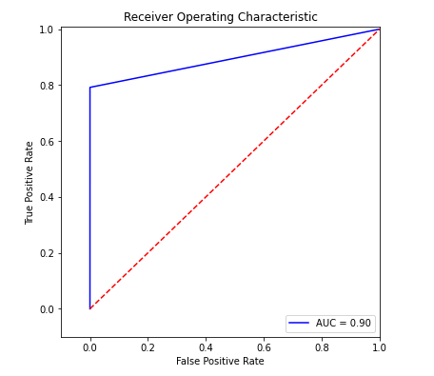
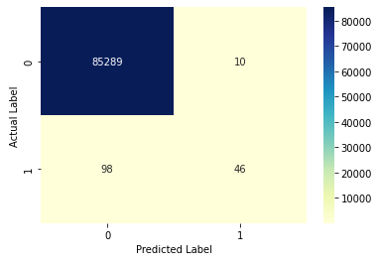
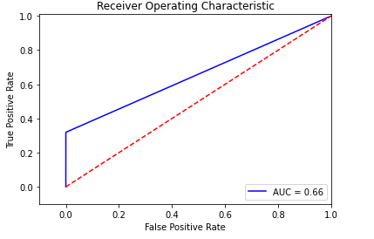
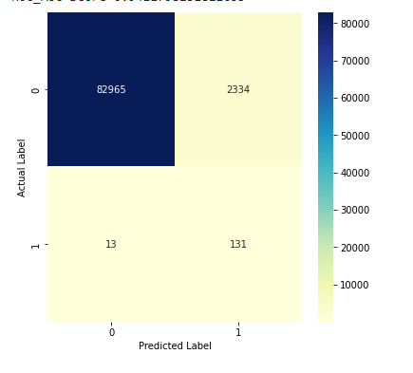
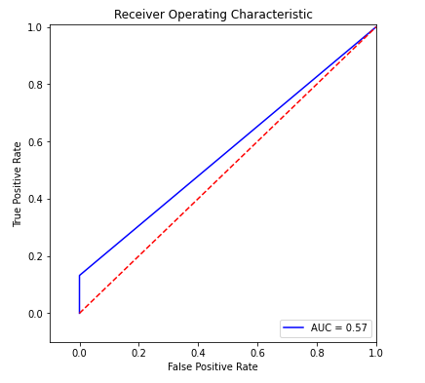
Results : Imbalanced Dataset
Logistic Regression
Random Forest Classifier
Support Vector Machine
Artificial Neural Networks

Slide 9

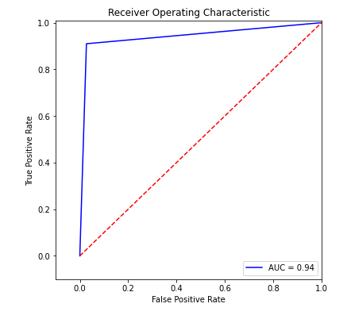
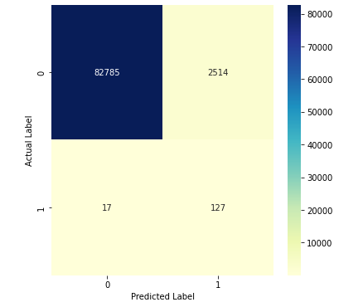
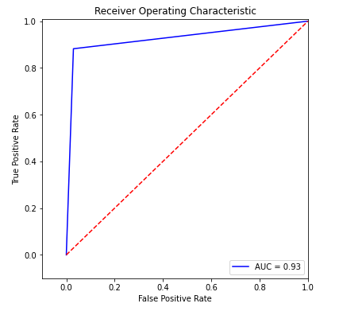
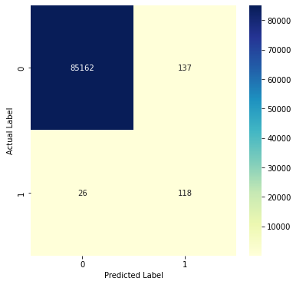
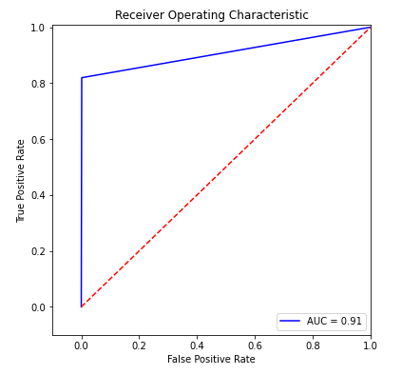
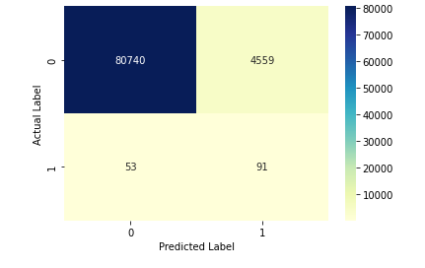
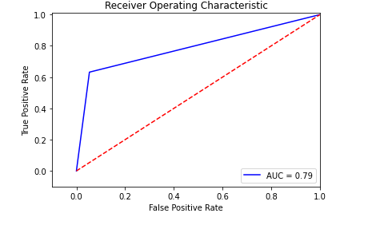
Results : Random Undersampling
Logistic Regression
Random Forest Classifier
Support Vector Machine
Artificial Neural Networks

Slide 10
Results : Random Oversampling
Logistic Regression
Random Forest Classifier
Support Vector Machine
Artificial Neural Networks

Slide 11
Results : Borderline
Logistic Regression
Random Forest Classifier
Support Vector Machine
Artificial Neural Networks

Slide 12
Results : ADASYN
Logistic Regression
Random Forest Classifier
Support Vector Machine
Artificial Neural Networks

Slide 13
Results : SMOTE
Logistic Regression
Random Forest Classifier
Support Vector Machine
Artificial Neural Networks

Slide 14
Results : SVM-SMOTE
Logistic Regression
Random Forest Classifier
Support Vector Machine
Artificial Neural Networks

Slide 15
Results : SMOTE-ENN
Logistic Regression
Random Forest Classifier
Support Vector Machine
Artificial Neural Networks

Slide 16
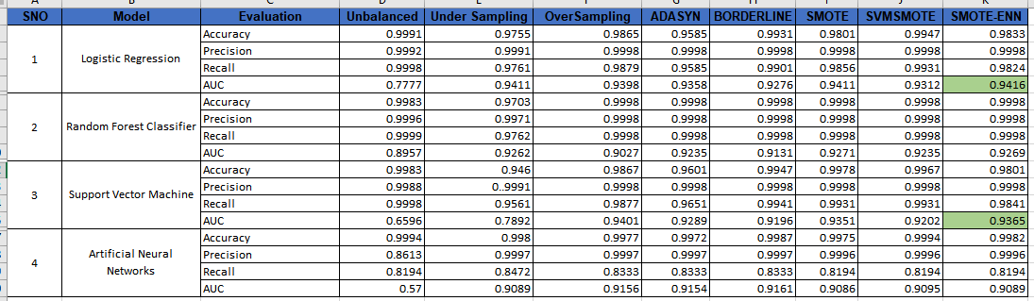
Results : A Comparative Analysis

Slide 17
References :
J. V. V. Sriram Sasank, G. R. Sahith, K. Abhinav and M. Belwal, "Credit Card Fraud Detection Using Various Classification and Sampling Techniques: A Comparative Study," 2019 International Conference on Communication and Electronics Systems (ICCES), 2019, pp. 1713-1718, doi: 10.1109/ICCES45898.2019.9002289.Bell, E., and Bryman, A. (2011). Business Research Methods, 3rd edition, New York: OUP Oxford. ISBN-10: 0199583404.
Ghosh and Reilly, "Credit card fraud detection with a neural-network," 1994 Proceedings of the Twenty-Seventh Hawaii International Conference on System Sciences, 1994, pp. 621-630, doi: 10.1109/HICSS.1994.323314.
E. I. Altman, G. Marco and F. Varetto, "Corporate distress diagnosis comparisons using linear discriminant analysis and neural networks", Journal of Banking and Finance, vol. 18, no. 3, pp. 505-529, 1994.
A.M. Flitman, "Towards analysing student failures: neural networks compared with regression analysis and multiple discriminant analysis", Computers & Operations Research, vol. 24, no. 4, pp. 367-377, 1997.
J.A. Ohlson, "Financial ratios and probabilistic prediction of bankruptcy", Journal of Accounting Research, vol. 18, no. 1, pp. 109-131, 1980.

Slide 18
Thank You…

